Slide 1

Expansion Overview
Year 11 Ancient History – Lesson 1
Ms Barrie HASS

Slide 2

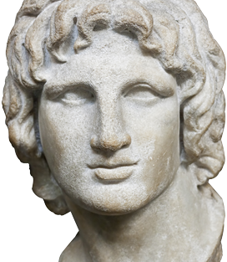
Why ‘The Great’? In ten years, Alexander of Macedonia created the largest empire in the world up to that time Alexander spread Greek culture, ensuring cultural diffusion and the survival of the qualities of classical Greece

Slide 3
What does this map teach you about ATG’s empire?

Slide 4
Securing/Expanding an Empire
Alexander squashed rebellions in the northern regions to the Danube River
In the process of reconquering the Greek city states, his forces destroyed Thebes, massacring all, including women and children
Alexander’s forces of over 40,000 crossed at the Dardanelles into Asia, where he declared that the whole of Asia would be won by the spear
Alexander’s forced dispatched the Persian army, losing only 110 men (legend)
Again Alexander was victorious, and Darius was forced to flee, abandoning his mother, wife and children to Alexander

Slide 5
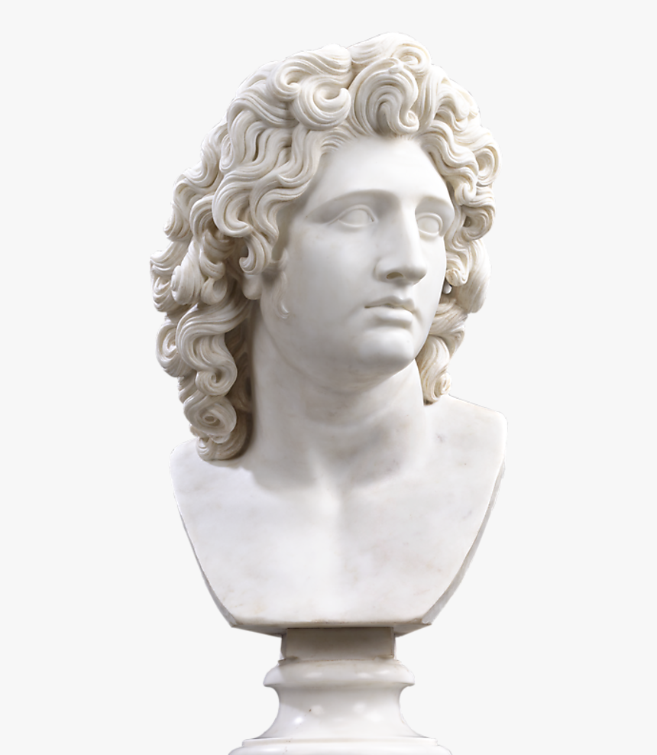
Major cities in Asia Minor and along the Phoenician coast surrendered to Alexander
Alexander proceeded to Egypt, where he established the city of Alexandria and was made pharaoh
Yet again, Alexander’s forces defeated Darius, this time in Mesopotamia
Alexander was proclaimed king of Persia and Darius’s royal city and palace were burned to the ground
Again, Darius fled… Alexander pursued
When Darius was found murdered by his own men, Alexander executed the assassins and gave Darius a royal funeral

Slide 6

Limits and Retreat
In the spring of 327 BC, Alexander and his army marched into India
As he conquered regions he allowed rulers to continue to govern in his name
In India, his horse Bucephalus was killed
At the Indus, the Macedonians rebelled and refused to go any farther
The forces travelled down the Indus and began the arduous journey back to Mesopotamia
His best friend, Hephaestion, died of a fever; to console himself, Alexander led a ferocious military campaign and went on a drinking binge

Slide 7
Securing a Legacy
Alexander made Babylonia the capital of his Empire
He married one of Darius’ daughters and “encouraged” 10,000 of his soldiers to take Persian wives
He died the following year at 33 before he could produce an heir and his kingdom was divided among 3 of his generals

Slide 8
Alexander’s Death
Alexander died of a fever at 33
Possible reports that he was had been plagued by several bad “omens”
Some others from the time claimed Alexander was poisoned during the drinking binge

Slide 9

Activity: Using the template create a storyboard/comic strip of ATG’s life. If incomplete, this will become homework. NOTE: These will be displayed.

